Slide 1
JAVA Lecture 16
Java Swing

Slide 2
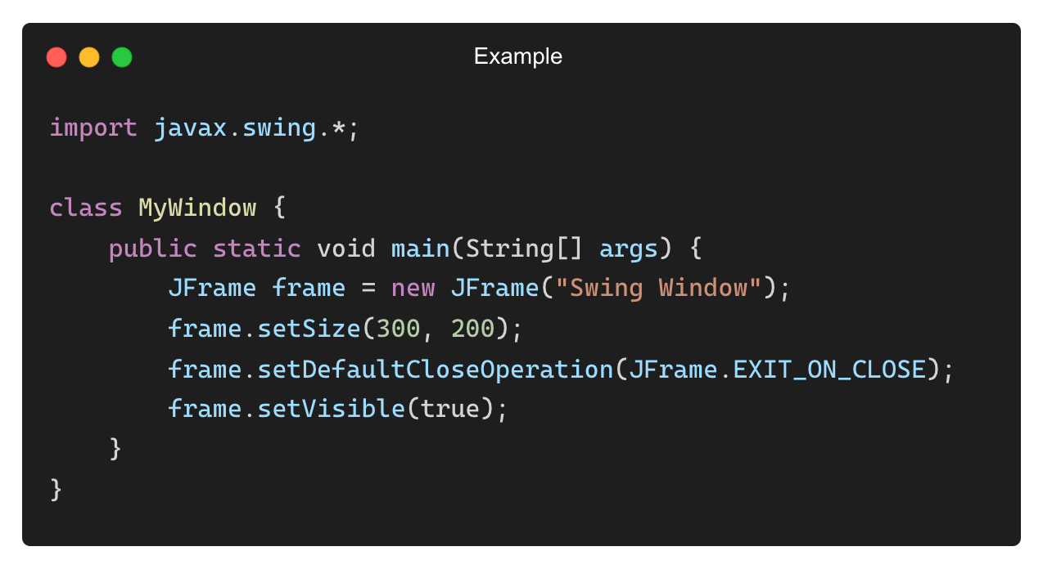
What is Swing in Java?
Swing is a part of Java’s GUI toolkit (javax.swing).
Why Use Swing?
✅ More powerful and flexible than AWT.
✅ Lightweight components (does not rely on OS).
✅ Supports MVC architecture for better GUI separation.
✅ Look-and-feel customization (Metal, Nimbus, etc.).
Example: A Simple Swing Window (Using JFrame)
Output: A window titled “Swing Window” opens.

Slide 3
Swing vs. AWT (Key Differences)
Feature | AWT | Swing
Lightweight? | ❌ No | ✅ Yes
Custom Look & Feel? | ❌ No | ✅ Yes
MVC Support? | ❌ No | ✅ Yes
Platform-Dependent? | ✅ Yes | ❌ No
Better Performance? | ❌ No | ✅ Yes

Slide 4
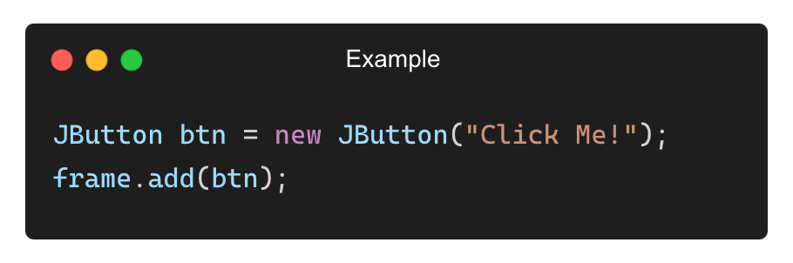
Key Swing Components
Swing Component | Description
JFrame | Main application window
JButton | Clickable button
JLabel | Displays text/images
JTextField | Editable text box
JTextArea | Multi-line text box
Example (Adding a Button to a Swing Window):

Slide 5
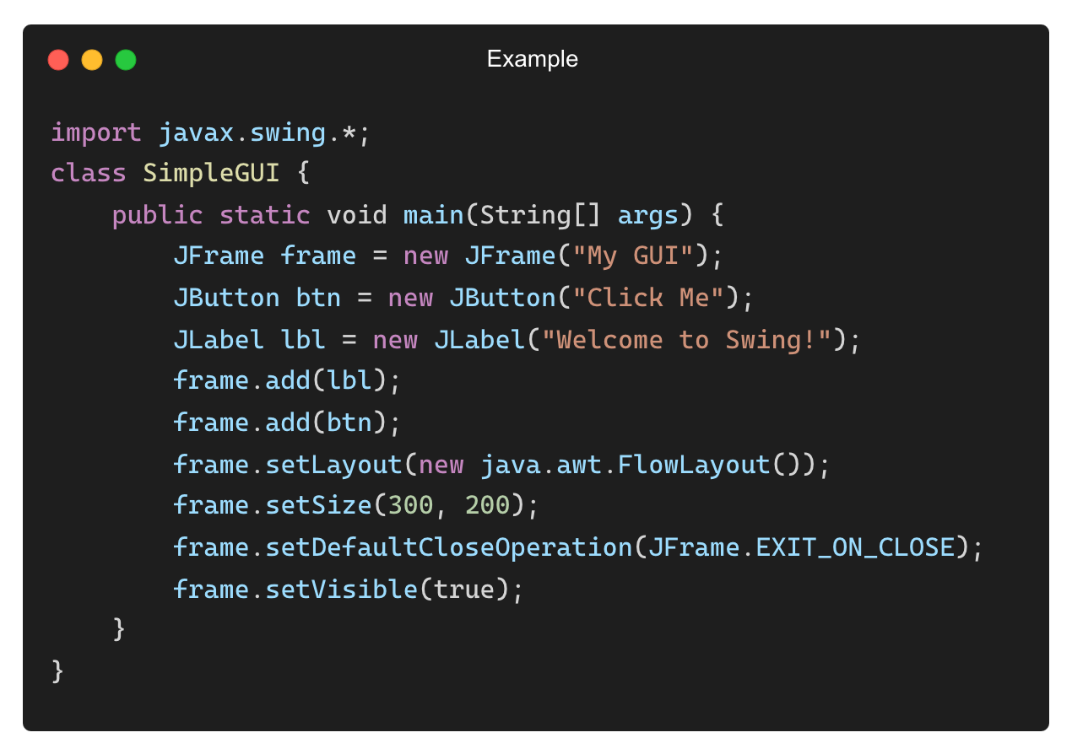
Creating a Simple Swing Application
Example: JFrame with a Label and Button
Output:
A window with a label and a button.

Slide 6
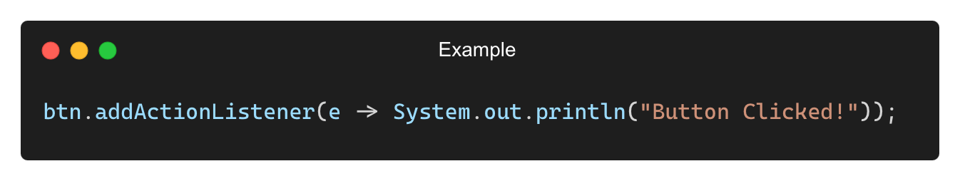
Handling Button Clicks in Swing
Use ActionListener to detect button clicks.
✅ Less code, efficient event handling.

Slide 7
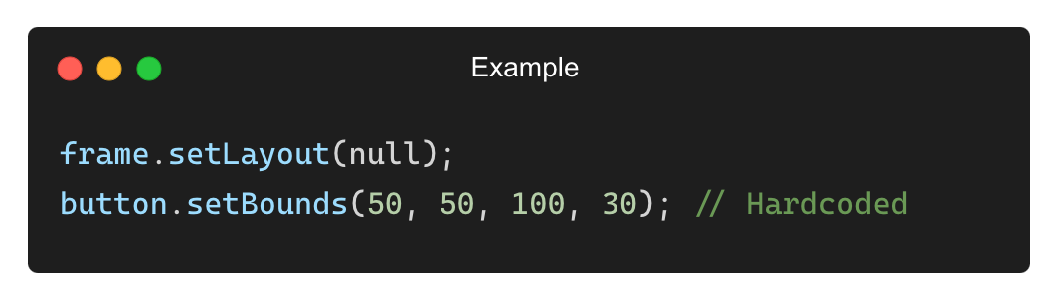
What is a Layout Manager?
A layout manager controls the arrangement of components in a Swing container.
Why use layout managers?
✅ Ensures consistent UI design across different screen sizes.
✅ Eliminates the need for manual positioning (setBounds()).
✅ Handles component resizing and alignment automatically.
Example Without Layout Manager (Hardcoded Positions, Bad Practice):

Slide 8
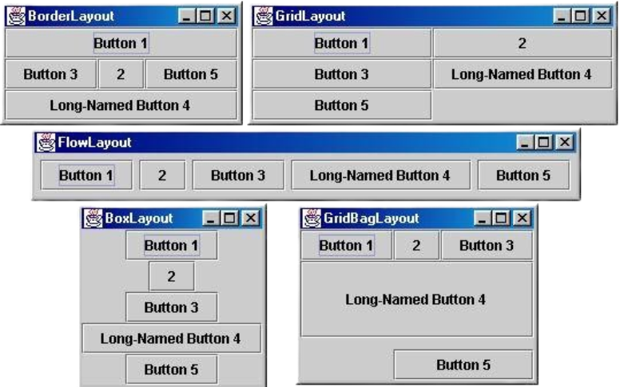
Types of Layout Managers in Swing
Layout Manager | Description
FlowLayout | Arranges components in a row, wraps to next line.
BorderLayout | Divides container into NORTH, SOUTH, EAST, WEST, CENTER.
GridLayout | Divides container into a grid of rows and columns.
BoxLayout | Aligns components horizontally or vertically.
GridBagLayout | Flexible layout with custom positioning (advanced).

Slide 9
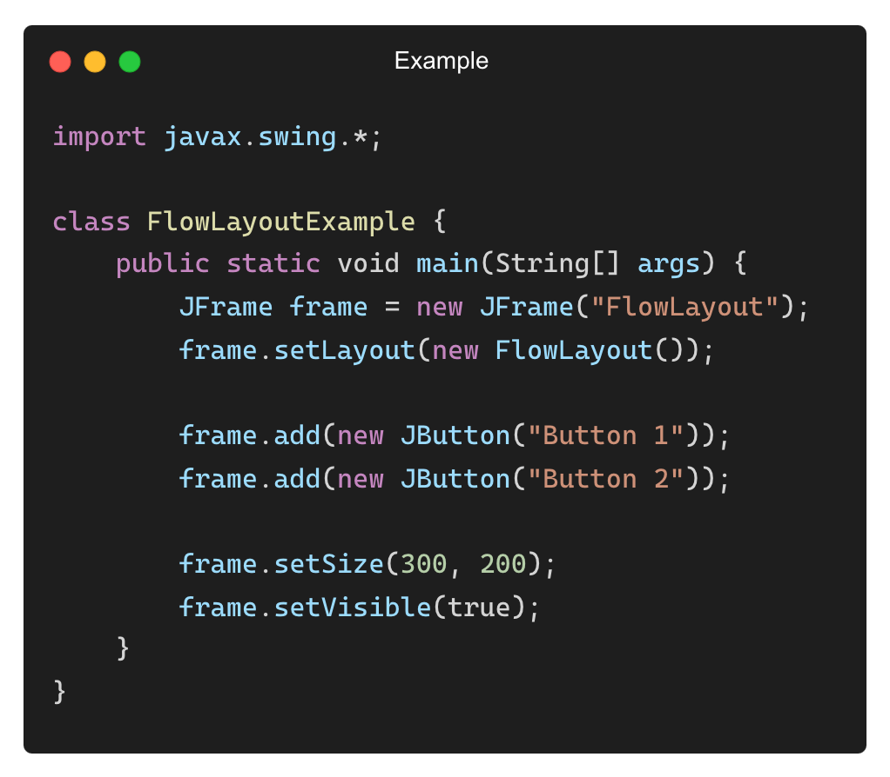
Using FlowLayout (Default Layout)
Components are placed from left to right, wrapping when needed.
Output: Buttons appear in a row, adjusting dynamically.

Slide 10
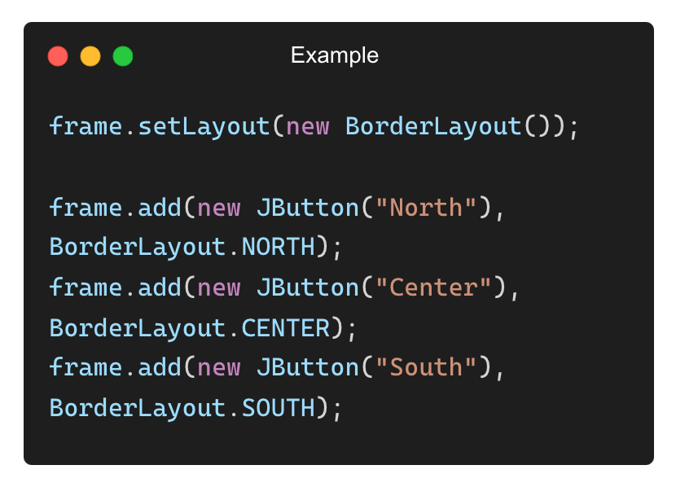
Using BorderLayout (Divides Container into 5 Regions)
Arranges components in NORTH, SOUTH, EAST, WEST, and CENTER.
Output:
North Button at the top
Center Button in the middle
South Button at the bottom

Slide 11
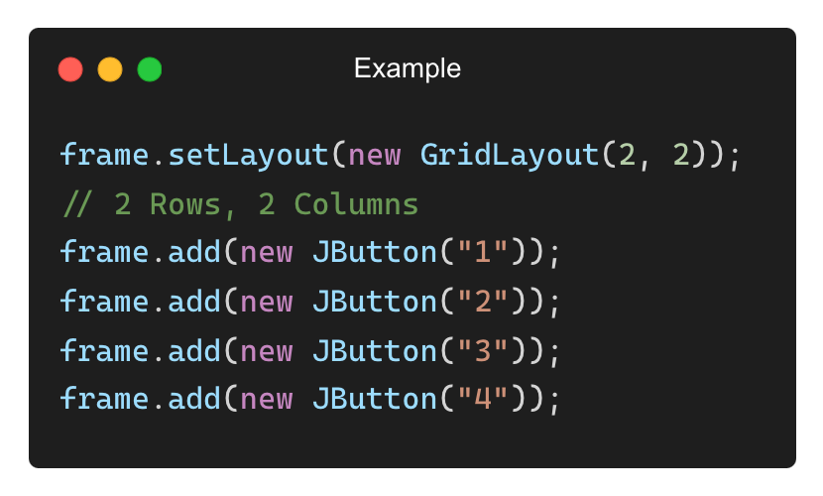
Using GridLayout (Grid-Based Arrangement)
Divides container into equal-sized cells.
Output: A 2×2 grid of buttons.

Slide 12
Steps to Create a Simple Swing Application
1️⃣ Create a JFrame (Main Window).
2️⃣ Add GUI components (JLabel, JButton, JTextField).
3️⃣ Use layout managers to arrange components.
4️⃣ Implement event handling for button clicks.
5️⃣ Set frame visibility to true to display the window.

Slide 13

Creating a Basic Swing Window
Example: A simple Swing window using JFrame
Output: A blank Swing window titled “My Swing App” appears.

Slide 14
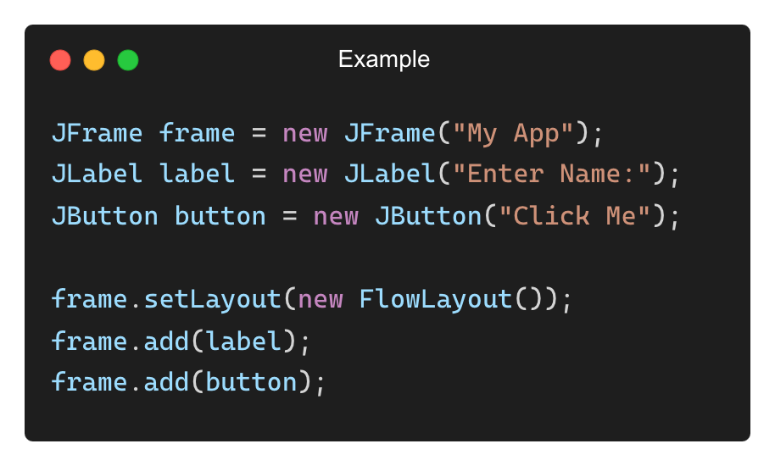
Adding Components to the Window
Example: Adding a Label and a Button
✅ Components are automatically arranged using FlowLayout().

Slide 15
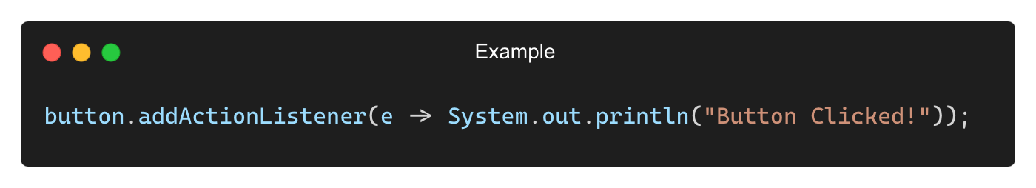
Handling Button Click Events
Printing a message when a button is clicked
Output:
Button Clicked!

Slide 16
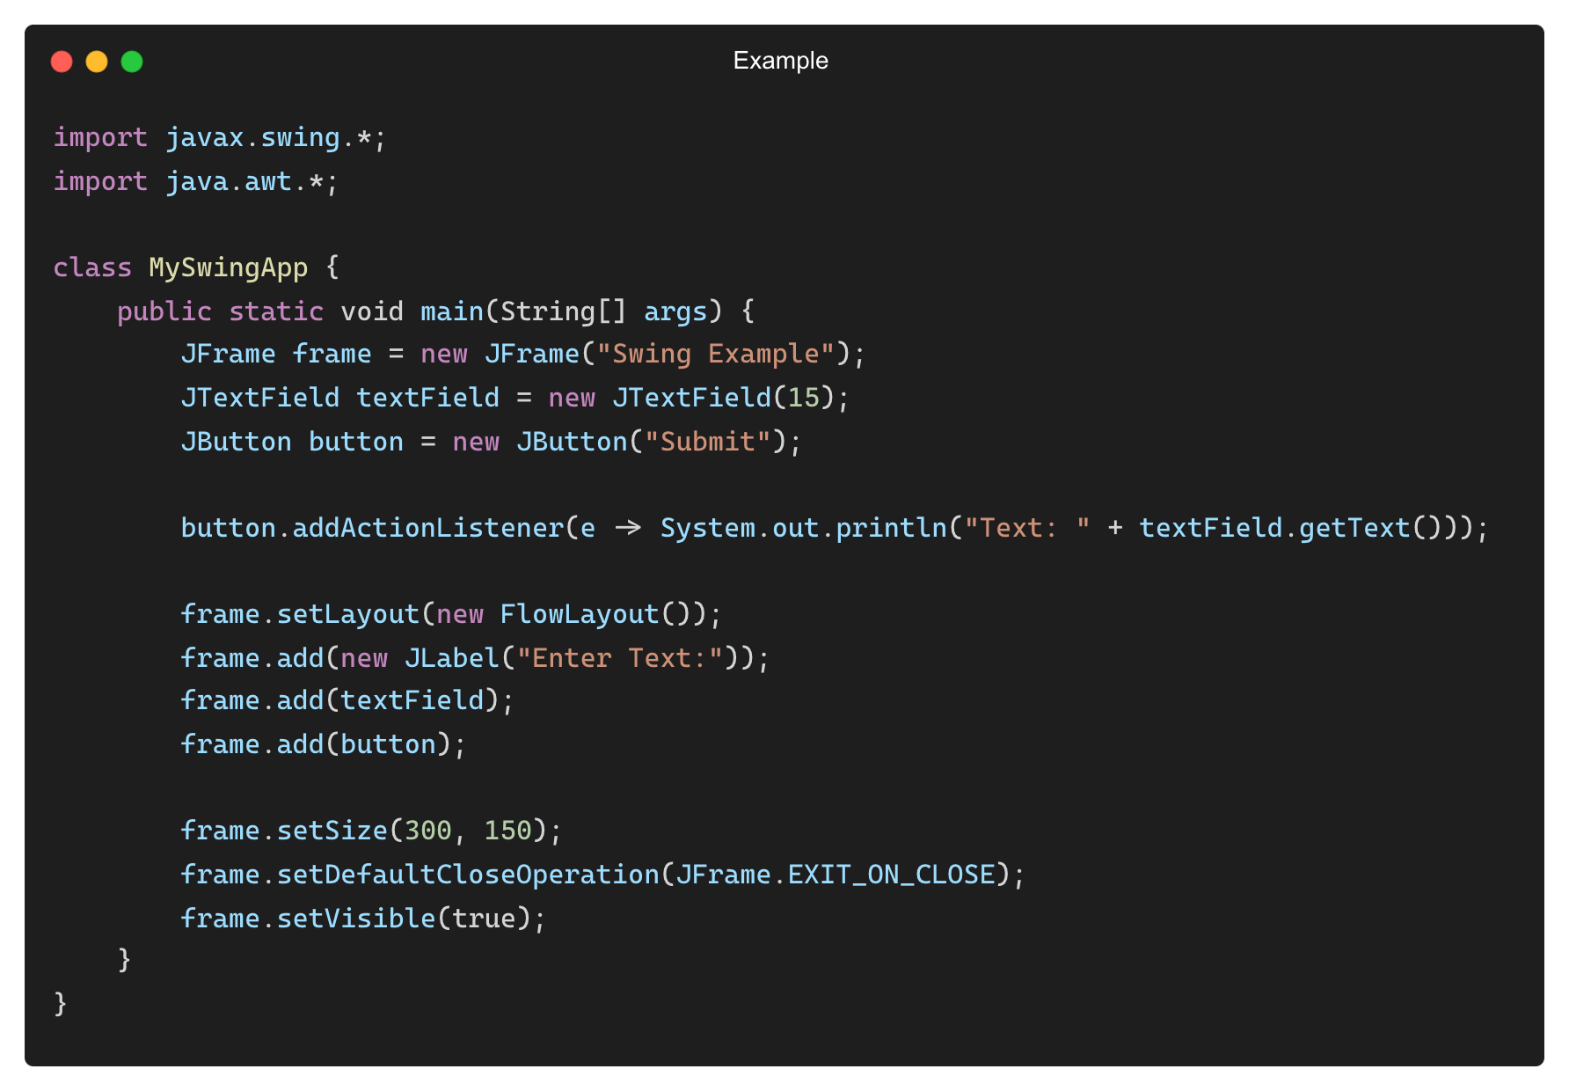
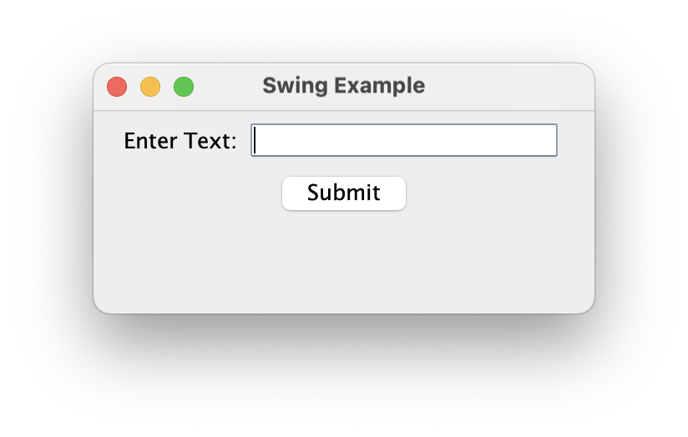
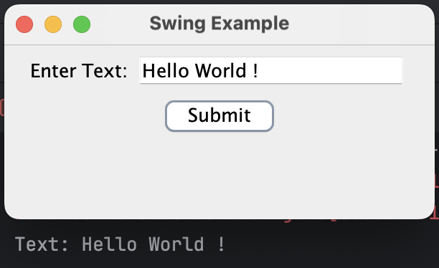
Complete Simple Swing Application
Example: JFrame with a Label, Text Field, and Button
Output:

Slide 17
THANK YOU

